Slide 1
Predicting Employee Attrition For IBM
Team Members: Karan Dassi, Tushar Jethani, Ann-Sophie Kouadio IV
Class: ITEC-621– Kogod Business School
Date: May 7th, 2019

Slide 2
Agenda
Business Problem
Dataset Description
Model Selection Process & Model Specifications
Relevant Results
Conclusions
Challenges

Slide 3
Business Problem
The Analytic Question: What will be the future employee turnover for IBM?
Articulation of Goals:
Interpretation: What are the most significant factors in determining employee turnover?
Inference/Prediction: Building a strong predictive model which can be referred for future predictions.
Business Case:
Improve their interactions with their employees before issues arise
Provide insights on future employee turnover in specific department and roles
Enable companies to take actions on the identified areas of concerns
Reduce costs of turnover related to employee resignations and terminations

Slide 4
Data Set Overview
Source
Observations
1470 employees
35 categorical & numerical variables
Important Variables
Attrition
Kaggle
Age
Business Travel
Job Level
Department
Job Satisfaction
Overtime

Slide 5
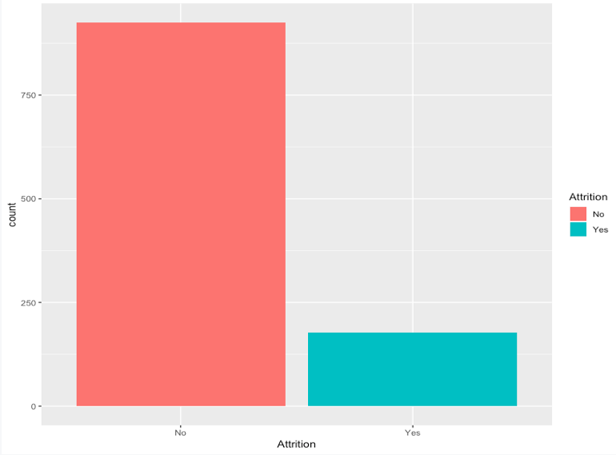
Descriptive Analytics-Overall Attrition at IBM
84% of Talent is retained.
16% of Talent left.

Slide 6
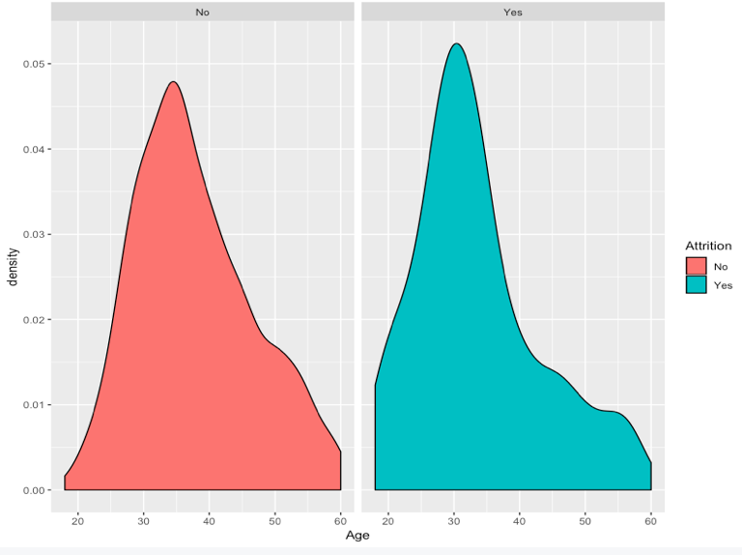
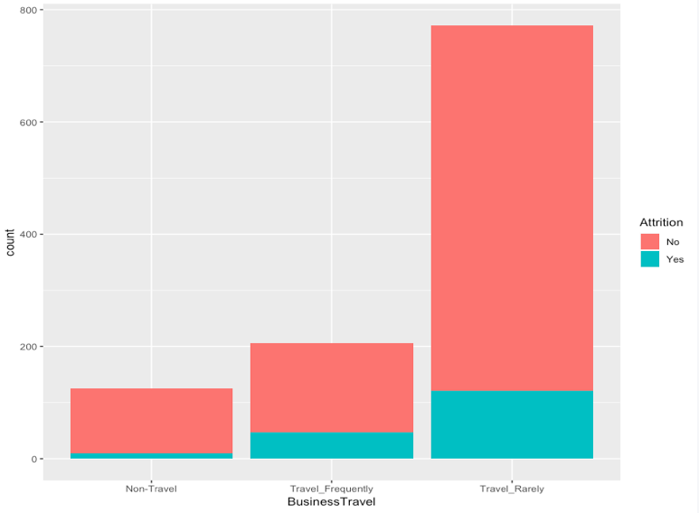
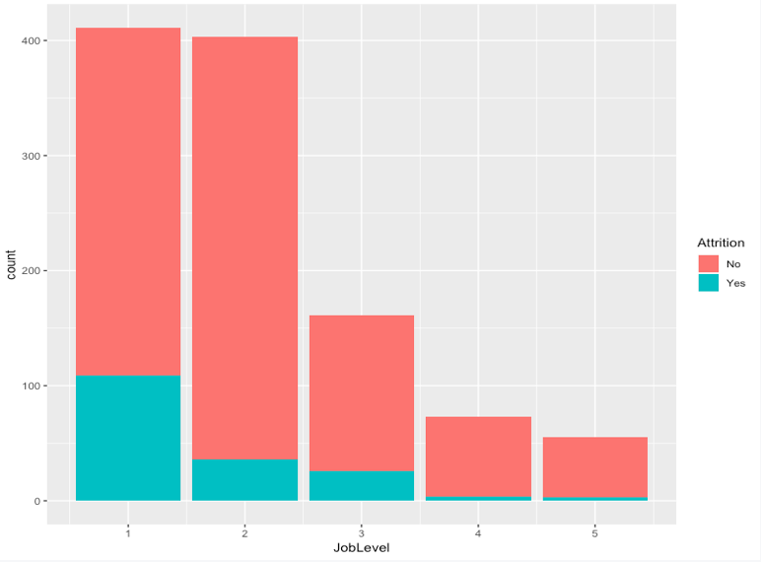
Descriptive Analytics- Some Relevant Factors
Attrition is greater within employees that travel rarely.
Employees that do not have much responsibilities tend to leave
Median Age of Employee leaving : 31

Slide 7
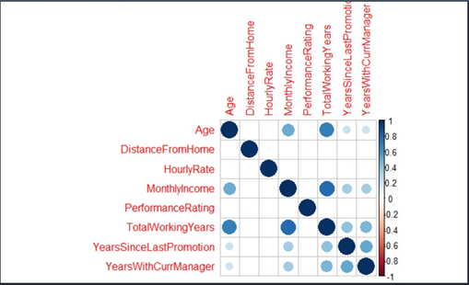
Data Pre Processing
1.Reduced full set of variables from 35 to 19 predictors
2.Created a Correlation matrix using all quantitative variables.
3.Checked for correlation between categorical variables using chi square test
4. Checked correlation between categorical and quantitative using box plots
5. Used stepwise regression to find the best set of variables
Correlation Matrix

Slide 8
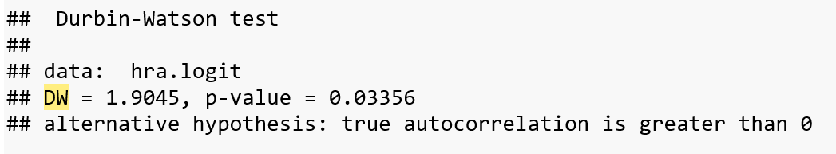
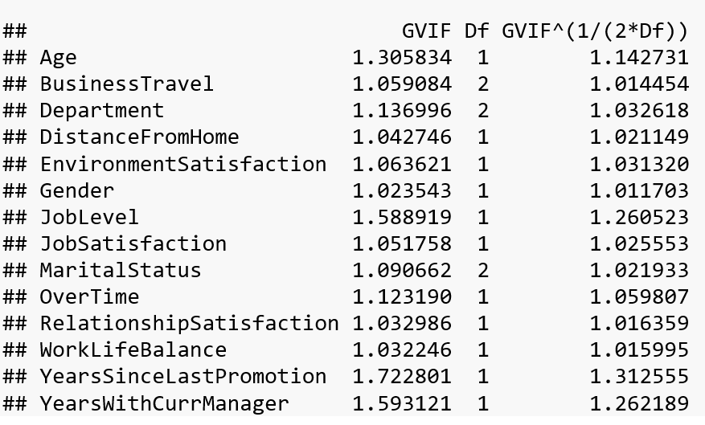



Assumptions
Observational independence
Appropriate Outcome Variable
Multicollinearity Check
DW Test: 1.9045
VIF: All close to 1
Large Sample Size
Notes:
Observational independence we mean elimination of serial correlation which we did discuss in the previous slides, we were able to eliminate Total working years using correlation, Overtime was also heavily correlated but was a very significant factor
Outcome variable is binary with a yeas and no response making it appropriate for logistic regression and classification trees
Checked for auto correlation by DW test which came out around 1.9 which fall well between 1.5 and 2.5 while 2 Is considered to be the best or no autocorrelation
Then Variance Inflation Factor checks for multicollinearity between predictors and all of of them have it close to 1 which is pretty good
Large Sample size and we do have 1470 observations here which is not that great but suffice our assumption

Slide 9
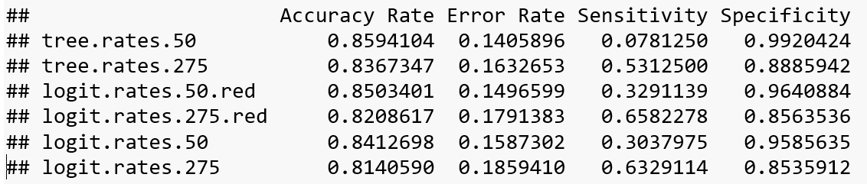








Model Selection
LOGISTIC REGRESSION
CLASSIFICATION TREE
Dependent variable (Y) is binary
Full, business and reduced
AIC from 1007 to 998
Area under ROC: 0.836
Full, business and reduced
Mindev = 0.05
Best number = 13
AIC of 1014
Area under ROC: 0.739
Notes:
Model Selection, we went ahead and choose to implement logistic regression and classification tree with the full dataset, the business reduced data set and then with the dataset after removing correlation and selecting final variables using stepwise regression.
As we can see that the outcome is binary
Alkaike Information Criteria reduced from 1007 to 998 for business to final reduced model which may not be that much significant but the resukts were pretty good
AIC checks for relative quality of statistical models.
We used a mindev of 0.05 to build a large enough tree to cross validate
Then we checked for misclassification to prune the tree and found that 13 nodes is the best tree for us
AIC of 1014
ROC – Reciever operating characteristic curve used for quality of tests is created for true positive rate vs false positive rate

Slide 10
Results
Most Important Predictors
Business Travel
Distance from home
Environment Satisfaction
Job Level
Job Satisfaction
Overtime
Logistic Model
20.07 percent employees will leave
Notes:
Finally using logistic regression at threshold of 0.275 we found out that 20 percent of employees will leave the company from the dataset
Which is still not that bad for IBM
Most important predictors are which can be managed by HR IBM department to reduce the attrition rates
As we have seen more the business travel there is slightly higher chance of an employee staying with the company
Less distance from home less is the attrition rate so HR department can provide more relocation allowance to not let people leave
Environment satisfaction can be improved by maybe adding more recreational activities like ping pong
People at lower job level tend to leave the company the company more readily than people at higher levels
Job satisfaction can also be improved by maybe providing some more perks like flexible hours, work from home
Overtime should be reduced or can be paid really well to reduce attrition

Slide 11
Conclusion
Best Model: Logistic Regression
Better Predictive Power
Consideration of factors
Use our model to improve profits
Notes:
We choose logistic because it has better predictive power for the case at hand
If IBMs HR department takes the factors into consideration discussed in the previous slide
They can easily reduce the proportion of employees leaving the company and thus increase the profits by not having to waste money on training new employees and in the process will not loose important employees.

Slide 12
Challenges
Large number of variables
Variable Manipulations
Hard to preprocess due to huge array of variables
Tough to apply codes due to various variety of variables
Choosing the right model

Slide 13
THANK YOU !

